Slide 1
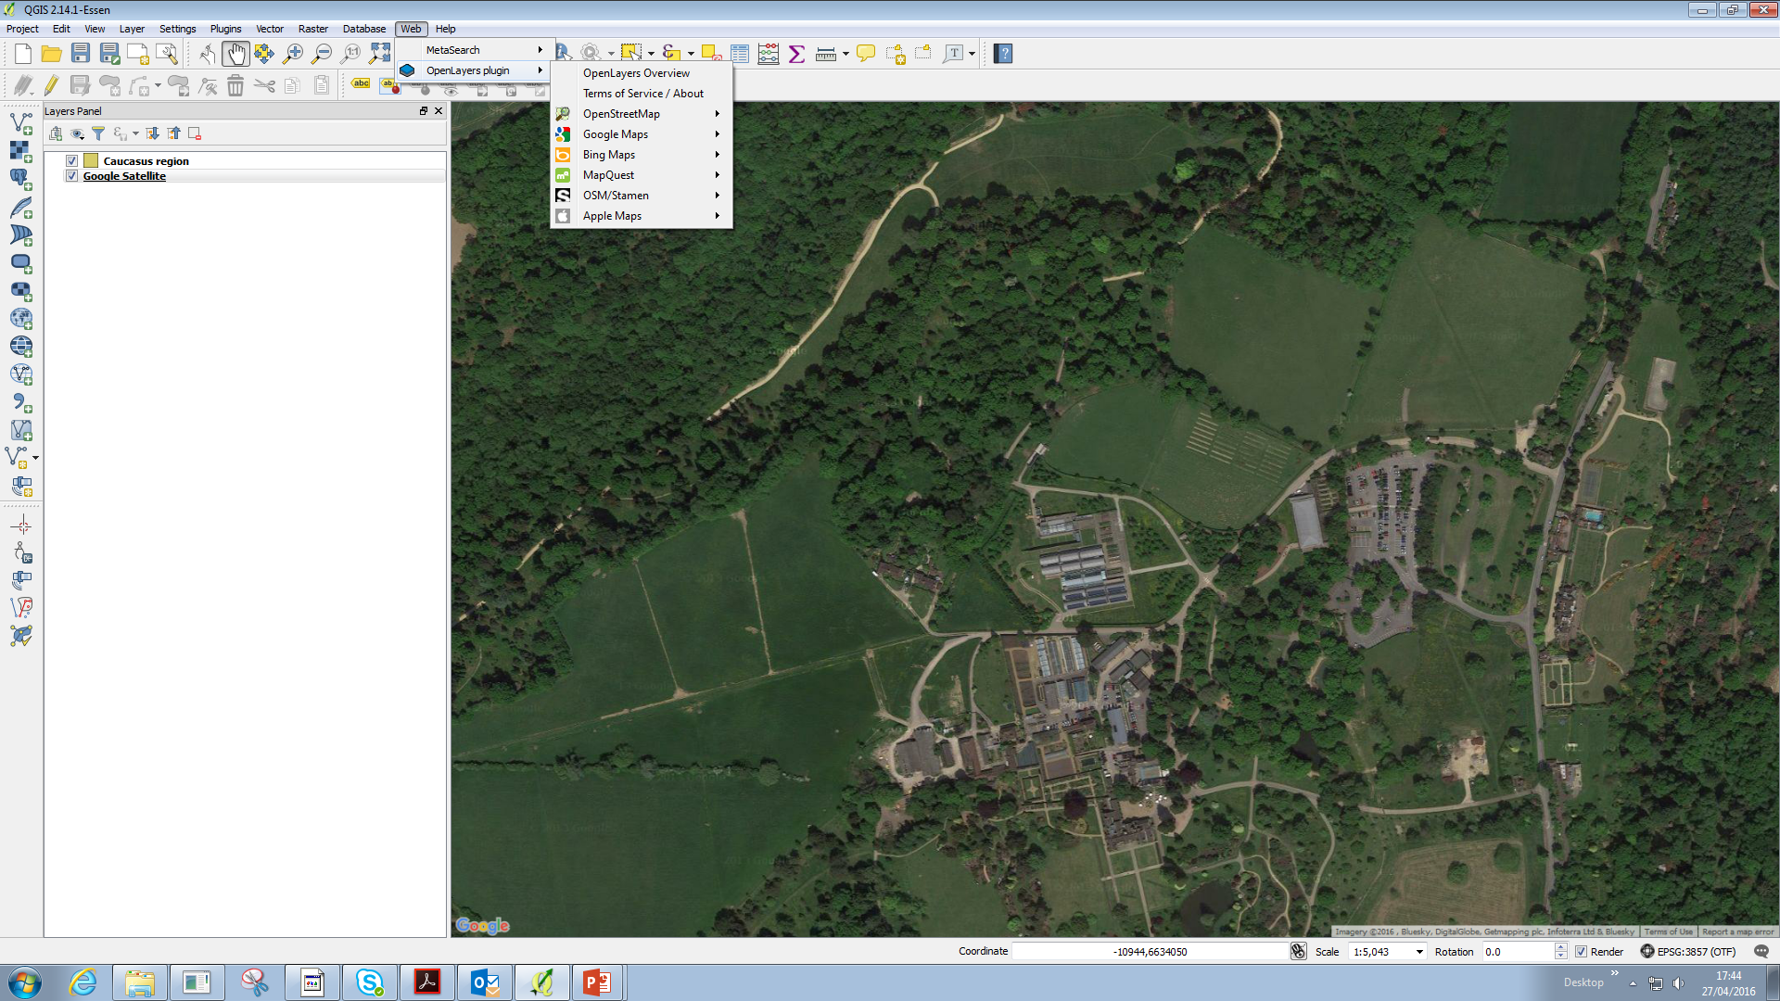
Plugins manager Open Layers Plugin
Potential proxy issues – limited time
Back-up plan – Wakehurst tiff file

Slide 2
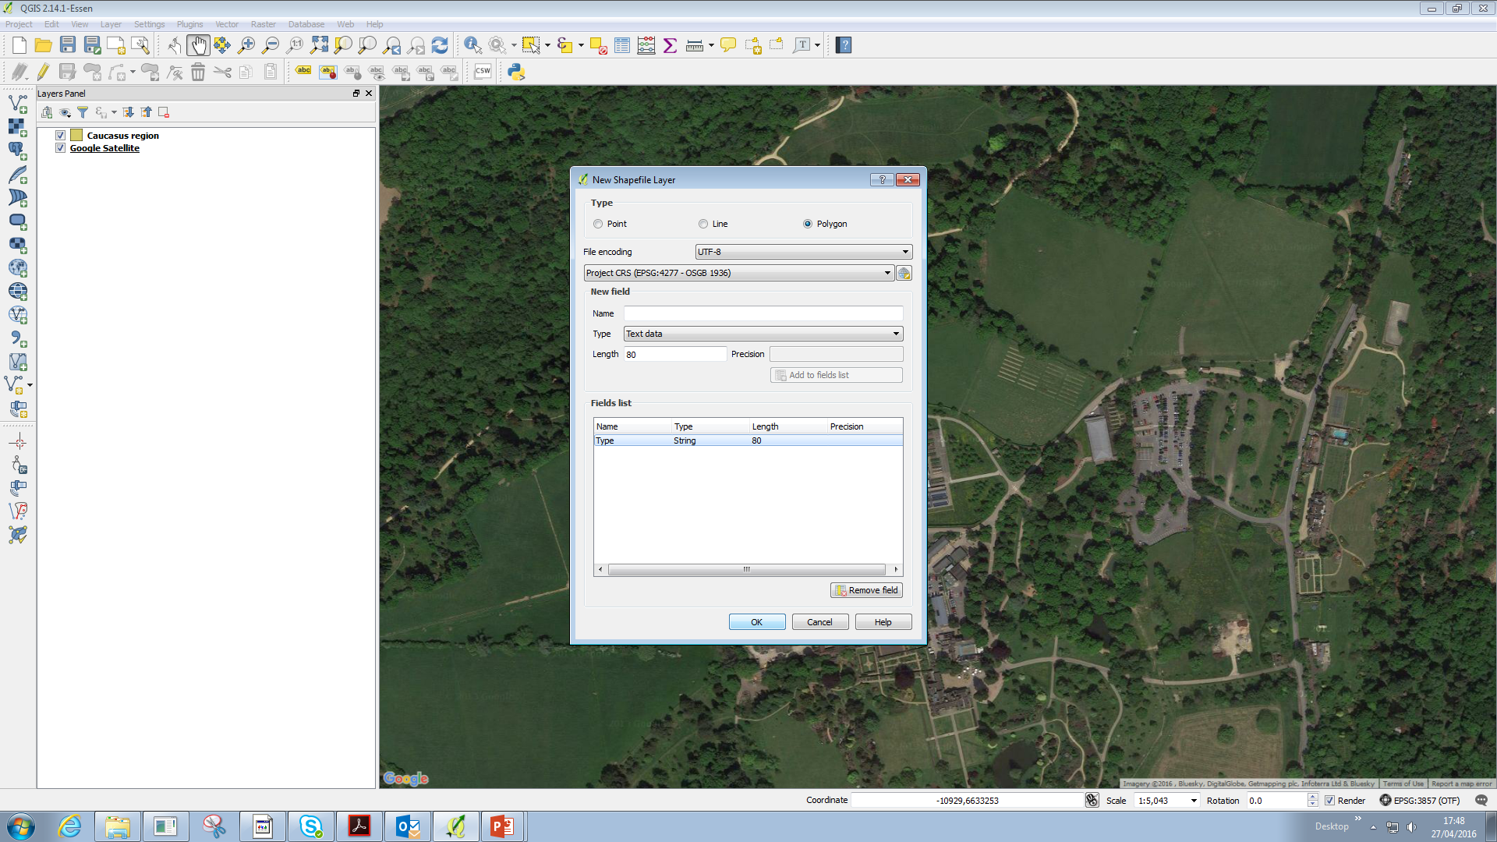
Layer – Create layer – New Shapefile
Toggle polygon
Change projection to EPSG 3857
Create new field called ‘Type’
Get rid of id field

Slide 3
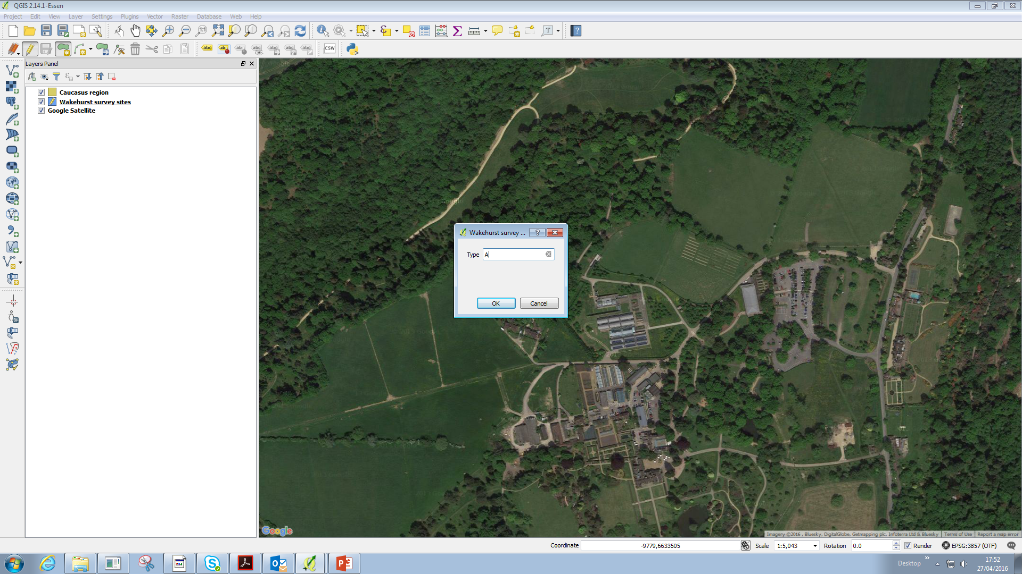
Save in QGIS folder – in named folder
Toggle Editing – Add Feature
Outline the seed hub
Call Type A
Do the same with B and D
Save and untoggle editing

Slide 4
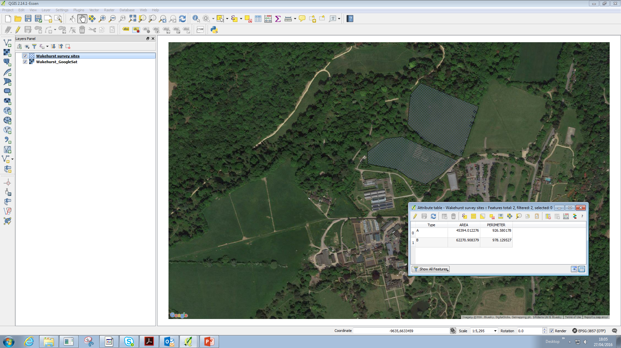
How big is our study area?
Vector – Geometry tools – Export/Add Geometry columns
Calculate using Project CRS
Measurements in m2

Slide 5
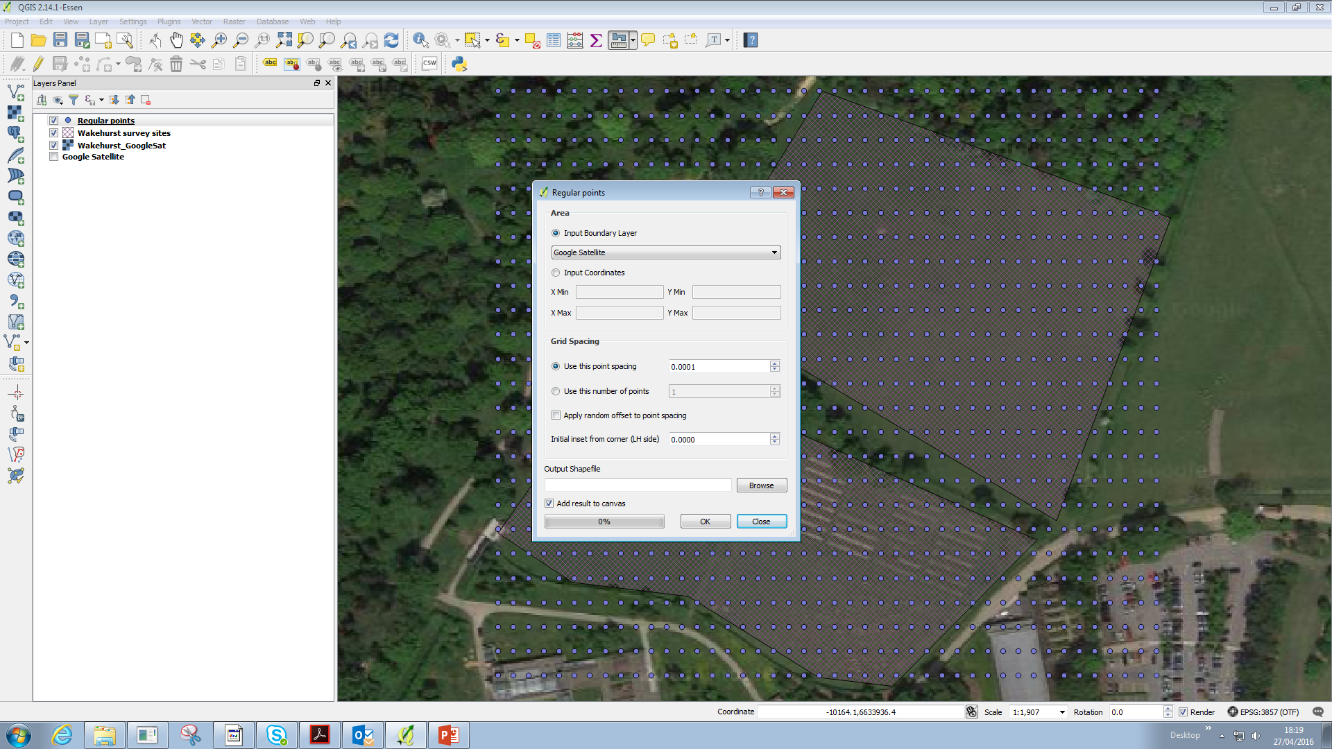
Add regular sample points
Vector – Research Tools
Input boundary layer and 100m spacing (0.0001)

Slide 6
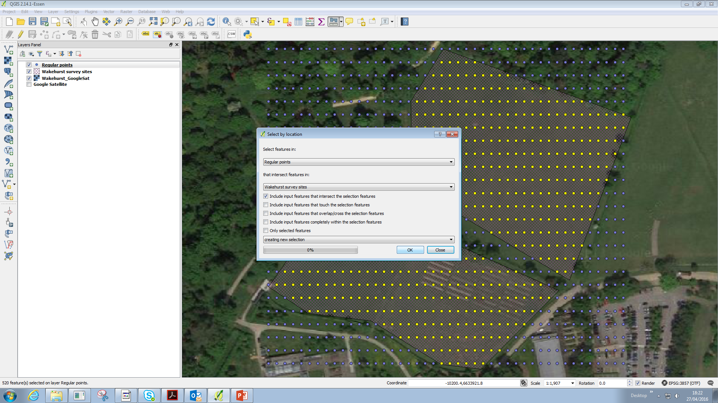
Need to get rid of the ones outside the boundary.
Vector –Research Tools – Selection by Location

Slide 7
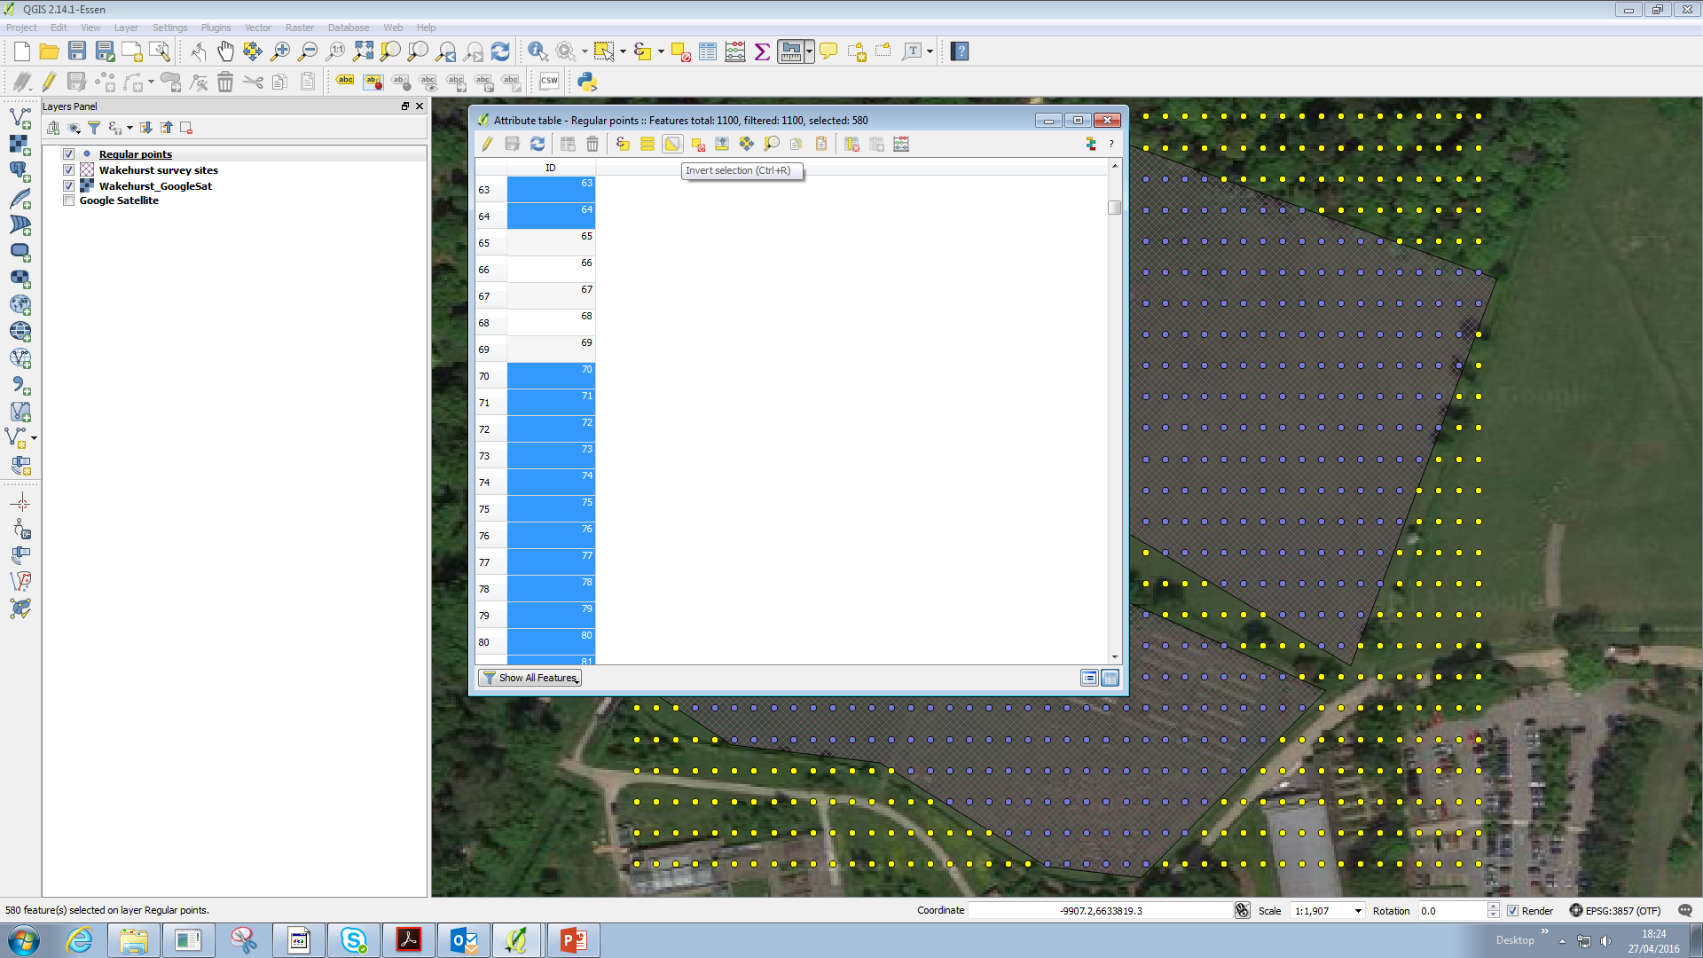
Open attribute table – Invert selection
Toggle editing
Delete
Save and untoggle edit

Slide 8
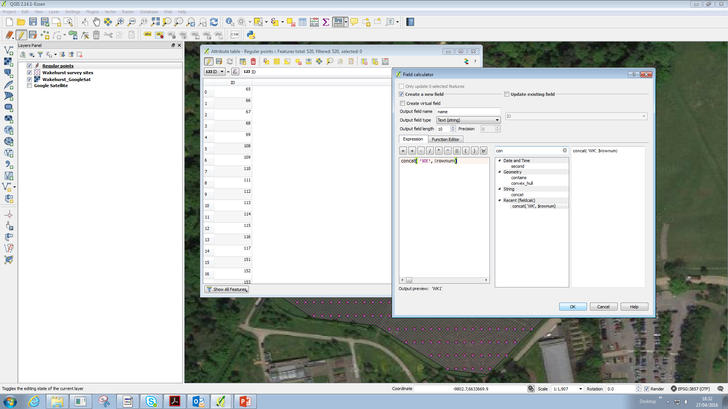
Inputting survey points to GPS
Open attribute table – toggle editing – field calculator
Create new field – title is name (small casing!) - text
Search for concat
Concat(‘WK’, $rownum)

Slide 9
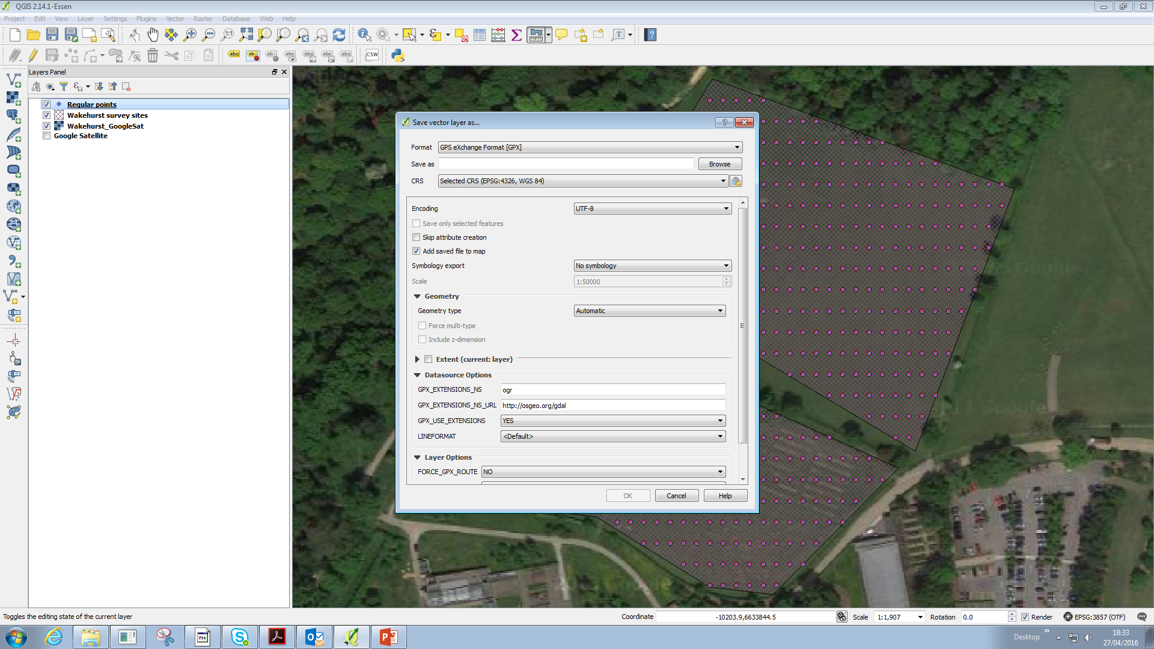
Right click the layer
Save as GPX file
Save to the folder of choice
When press ok, it will try and add the layer again
Select Waypoints
Good way of seeing if it’s done it or not

